Slide 1
WAKE UP ALARM
-Uma Devi pellivilla(1602-20-737-056)
-Thirupathi Ramneni(1602-20-737-031)
-Asaddudin .Md(1602-20-737-024)
-

Slide 2

ABSTARCT
An Alarm clock Is Designed to alert an individual
The Main theme of project is to Awaken people
For this project, We have used GUI, Libraries like Tkinter, play sound, random etc and Threads

Slide 3
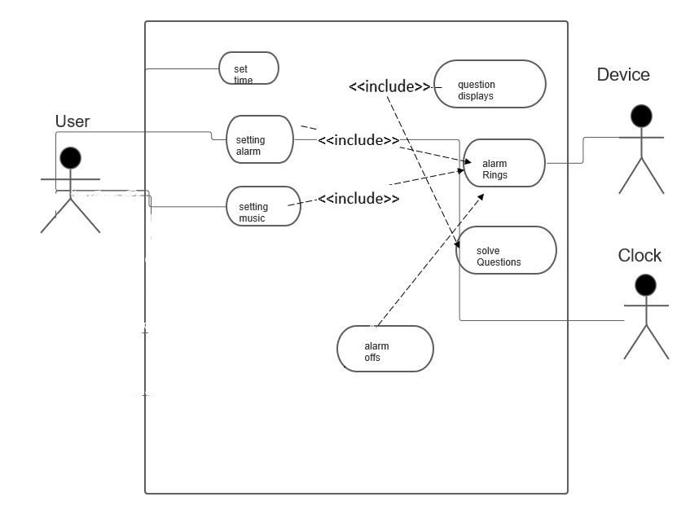
Use Case Diagram

Slide 4
Technology used
a. Hardware Requirements
The hardware components used in order to create the wakeup(alarm) are as follows
• Computer with 2GB RAM
•Ringtone downloads
•Internet
•External drives for backup
b.Software Requirements
•We use pychram in order to develop the code for the game
•We use our downloaded sounds to set as ringtone.
•Operating System. We have chosen Windows operating system for its best support and user friendliness

Slide 5
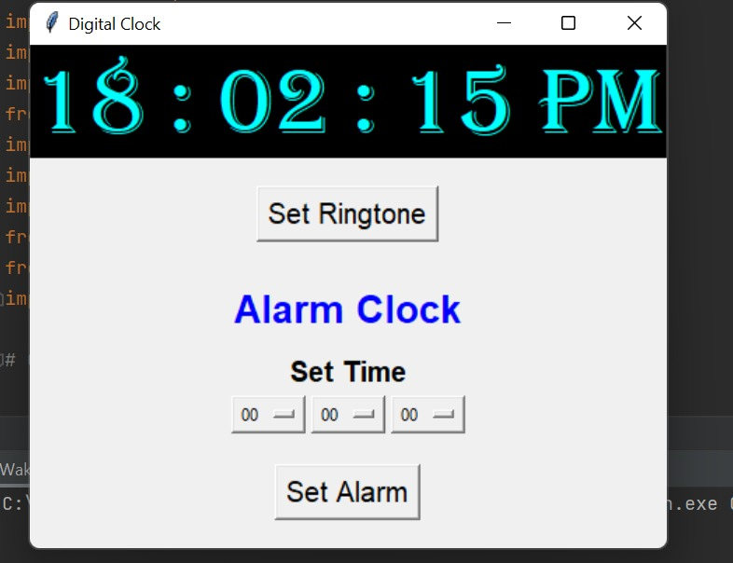
Screenshots and Executions

Slide 6
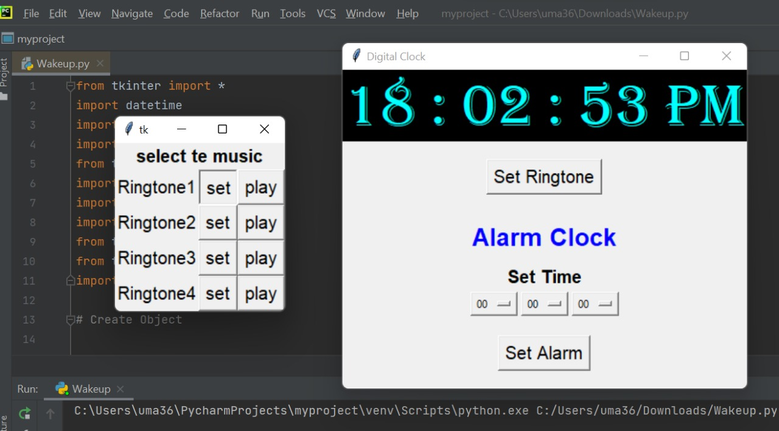

Slide 7
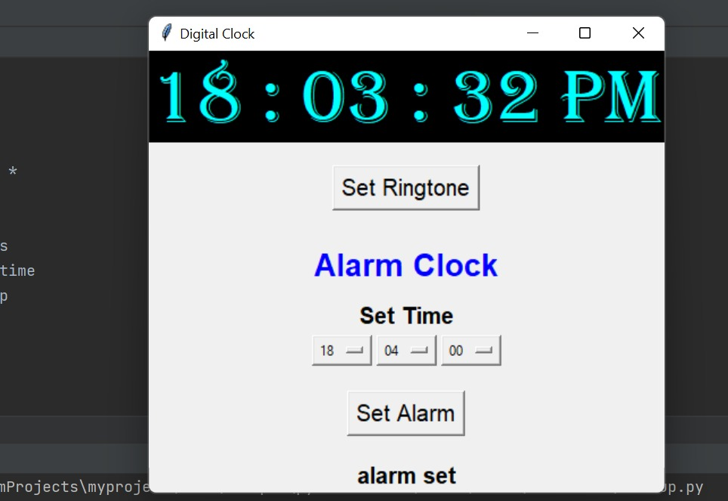

Slide 8
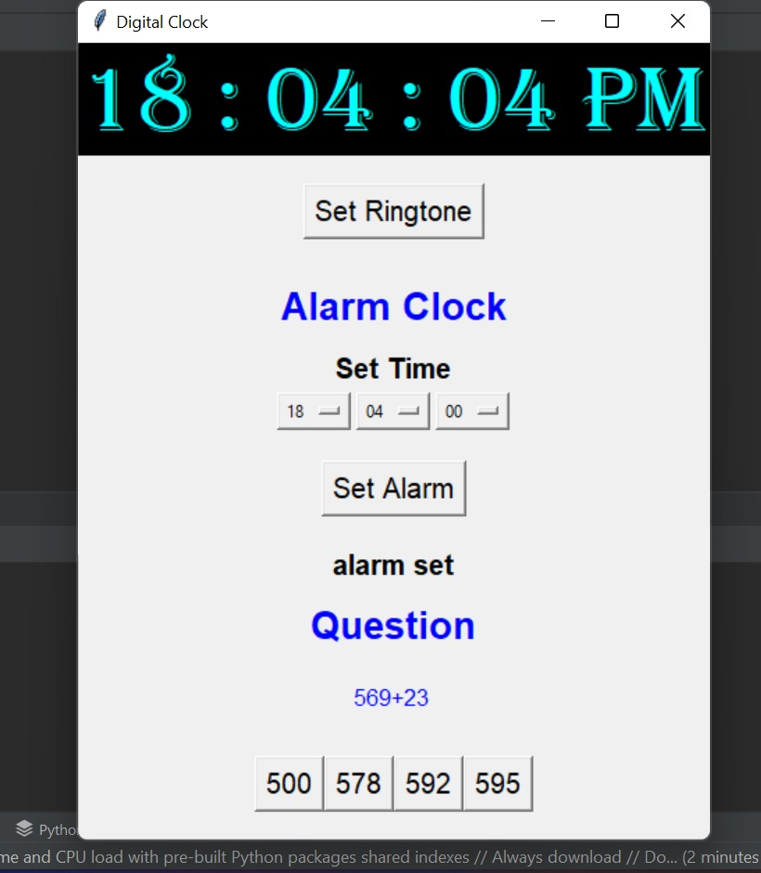

Slide 9
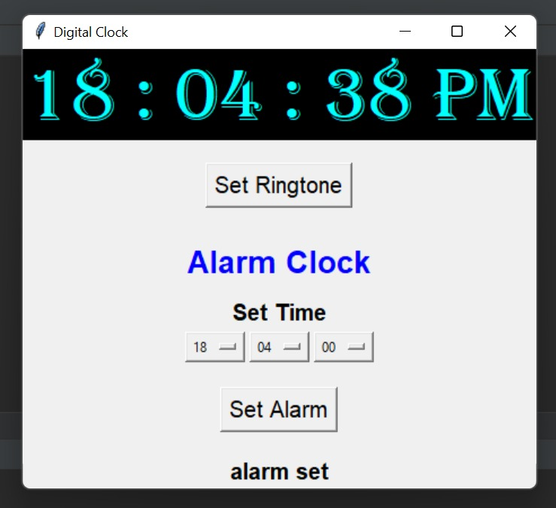

Slide 10
Conclusion And Future Work
We want to make the user to set the question type. Up to now user will get random questions.
Improve Graphical Representation and make it more interesting.
Introduce new features by asking questions by displaying pictures for kids where kids are users.
And the questions and music will be set according to the users age in default.
The project is successfully implemented with all the features in wakeup is as per the requirements.

Slide 11
THANK YOU

